Slide 1
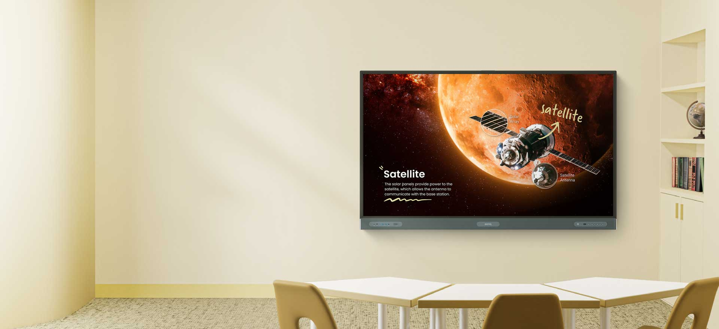
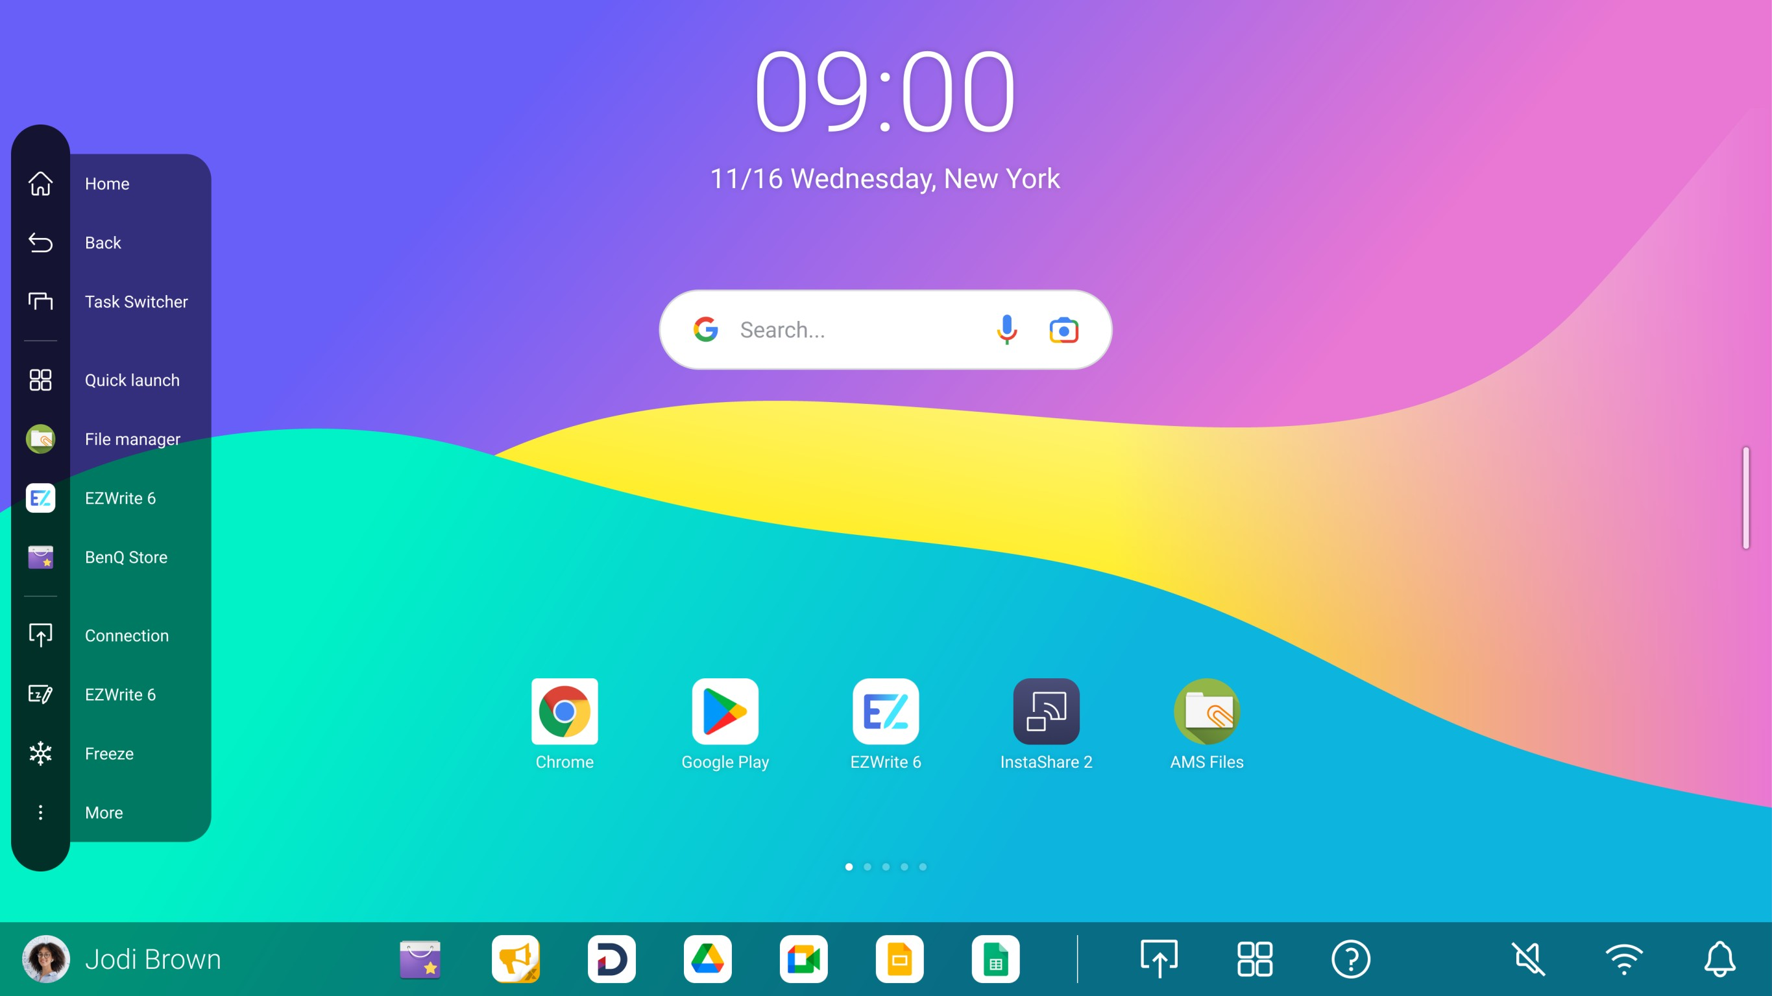

Teach in ways you never imagined
Take your teaching to the next level with our most powerful board yet
BenQ Board EDLA-certified interactive flat panel
Comparisons

Slide 2

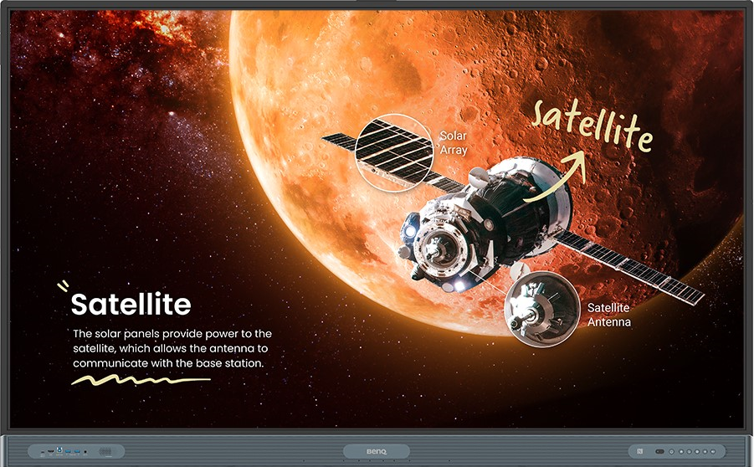

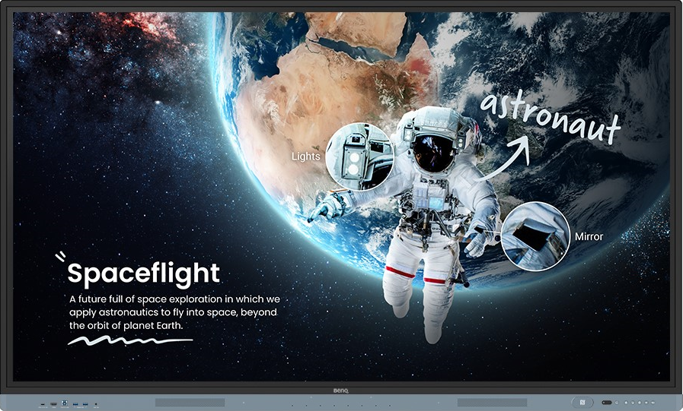


EDLA
BenQ Board
GMS-Certified
GMS-Certified
Product Specifications | RP04 | RM04
Available sizes | 65’’, 75’’, 86’’ | 65’’, 75’’, 86’’
4K (UHD) resolution | ● | ●
Touch technology | Fine IR+ (Infrared) | Fine IR+ (Infrared)
Bonding technology | Zero bonding | Zero bonding
Touch points | 50 | 40
Response time | 8ms | 8ms
Cover glass | 3.2mm, 9H tempered, Anti-glare | 3.2mm, 9H tempered, Anti-glare
Panel life expectancy | 50,000 | 50,000
Brightness (nits) | 450 | 450
SoC | Octa-core A78*4 + A55*4 | Octa-core A73*4 + A53*4
Memory / Storage | 64GB/128GB | 32GB/128GB
OS (PC-free experience ) | Android 13.0 | Android 13.0
BenQ Comparison Table

Slide 3
Product Specifications | RP04 | RM04
Motion sensors | ● | ○
Ambient light sensors | ● | ●
Temperature & humidity sensors | ● | ○
Indoor air quality sensors | CO₂, PM_{2.5}, PM₁₀ TVOC, CH₂O | ○
Air ionizer | ● | ○
Integrated speakers | 20W x 2 | 20W x 2
Subwoofer | 16W x 1 | ○
Array microphone | x 8 (Pickup range: up to 8M) | x 8 (Pickup range: up to 8M)
Battery-less stylus | x 2 | x 2
Sound Bar | ● | ○
Front I/O | Mic in 5-in-1 USB-C (PD 100W charging) SmartPort USB-A x 2 USB-B HDMI in | Mic in 5-in-1 USB-C (PD 65W charging) SmartPort USB-A x 2 USB-B HDMI in
Top USB port for camera | USB-C x 1, USB-A x 1 | USB-C x 1, USB-A x 1
BenQ Comparison Table
Notes:
5 in 1 USB-C
*Display
*Audio
*Touch
*PD 65W
*Data transfer

Slide 4
Product Specifications | RP04 | RM04
USB-A | 8 (3.0 x 7, 2.0 x 1) | 7 (3.0 x 5, 2.0 x 2)
USB-B | 3.0 x 3 | 3.0 x 3
USB-C | Front side x 1 Rear side x 2 Top side x 1 | Front side x 1 Rear side x 1 Top side x 1
HDMI (in | out) | 2.0 x 4 | 2.0 x 1 | 2.0 x 3 | 2.0 x 1
RS232 input | x 1 | x 1
DP in | 1.2a x 1 | 1.2a x 1
VGA in | x 1 | x 1
Mic in | x 1 | x 1
PC audio in | x 1 | x 1
3.5mm line out (stereo out) | x 1 | x 1
SPDIF out | x 1 | x 1
OPS slot | x 1 | x 1
Ethernet LAN | 1000 Mbps x 2 | 1000 Mbps x 2
NFC reader | ● | ●
Touch Pen | NFC Stylus x 2 | Stylus x 2
Built-in Wi-Fi | ● | Optional
Built-in Bluetooth | ● | Optional
Wi-Fi dongle protection | ● | ●
BenQ Comparison Table

Slide 5







Healthcare Features | RP04 | RM04
Germ-resistant solutions
Touchscreen
Stylus
Remote control
Front buttons, power button
Front I/O ports |  | ○
Air quality solutions
Air ionizer |  | ○
CO2 sensor | ● | ○
PM2.5 & PM10 sensor | ● | ○
TVOC sensor | ● | ○
Eye care solutions
Low blue light
Flicker-free screen
Anti-glare screen | ● | ●
4K UHD screen | ● | ●
Dust Protection solution
IP5X

Slide 6


